Slide 1

Olist
E-COMMERCE
ANALYTICS
Team Members (Group-4):
Riya Jitendra vishwakarma
Nikhil Rohidas Naik
Siddesh satish kadam
Medabala Sujith Kamal Kumar
Akshata P sutar
Harshada Arvind chavan
Tammisetty Joji
Mentor Name:
Dipti Sinha

Slide 2
TABLE OF CONTENTS
01
INTRODUCTION
DATASETS
PROJECT PROCESS
TOOLS USED FOR ANALYSIS
KPI’S
DASHBOARD IMAGES (EXCEL, TABLEAU, POWER BI)
INSIGHTS
RECOMMENDATIONS
CONCLUSION
02
03
04
05
06
07
08
09

Slide 3
INTRODUCTION
Overview: The project analyzes e-commerce data to understand sales, customers, products, payments, and delivery performance.An interactive dashboard converts raw data into clear and actionable business insights.
Objective: To identify important trends and KPIs that influence e-commerce business performance.To support data-driven decisions by analyzing customer behavior, sales, and operational efficiency.
Company Background: E-commerce platforms generate large amounts of data from orders, customers, products, payments, and reviews.Analyzing this data helps businesses understand performance, improve operations, and increase customer satisfaction.
Market Position: Analytics helps e-commerce businesses monitor performance, identify growth opportunities, improve customer retention, optimize sales strategies, and make data-driven decisions.

Slide 4

DATASETS
olist_orders_dataset
olist_order_items_dataset
olist_order_payments_dataset
olist_order_reviews_dataset
olist_customers_dataset
olist_products_dataset
olist_sellers_dataset
olist_geolocation_dataset
product_category_name_translation

Slide 5
PROJECT PROCESS
Extract Data:
Transformation:
1
2
Collected and extracted the 9 Olist e-commerce datasets containing orders, customers, products, payments, reviews, sellers, and location data.
Cleaned the data, handled missing values and duplicates, transformed data types, and joined related datasets using common keys.
KPI & Visualization:
Dashboard:
3
4
Calculated key metrics such as total orders, sales, payment value, delivery time, and review scores, then represented them using charts and graphs..
Developed an interactive dashboard with KPIs, visualizations, filters, and business insights to support data-driven decision-making.

Slide 6




TOOLS USED FOR ANALYSIS
EXCEL
Power BI

Slide 7
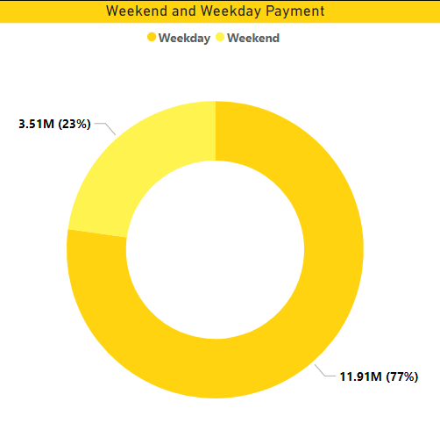
Business Performance KPIs
Key Performance Indicators
Total Orders: 99,441
Total Customers: 99,441
Total Payment Value: R$16.01M
Total Item Sales: R$13.59M
Total Order Items: 112,650
Observation :
The dataset contains nearly 100K orders and customers, generating more than R$16 million in total payment value. The volume of transactions indicates a large and diverse e-commerce operation.
Conclusion :
The business has a strong transaction volume and significant sales activity, providing a large data foundation for analyzing customer behavior, sales performance, and business growth.

Slide 8
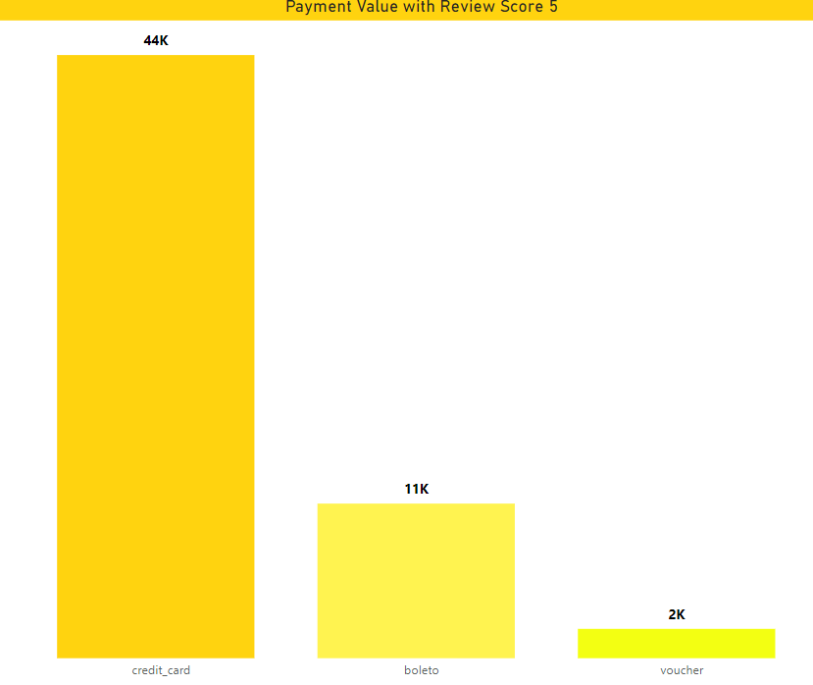
KPI 2: Number of orders with review score 5 and payment type credit card
Key Performance Indicators:
Average Delivery Time: Measure of logistics efficiency
Average Review Score: Measure of customer satisfaction
5-Star Review Rate: Highly satisfied customers
Weekday vs Weekend Sales: Identifies purchasing patterns
Payment Method: Identifies customer payment preferences
Observation:
Customer reviews and delivery performance provide important indicators of customer satisfaction, while payment and purchasing patterns reveal how and when customers prefer to shop.
Conclusion:
Improving delivery efficiency and customer satisfaction can strengthen customer experience and support better retention, while purchasing and payment patterns can help optimize sales strategies.

Slide 9
DASHBOARD IMAGES

Slide 10
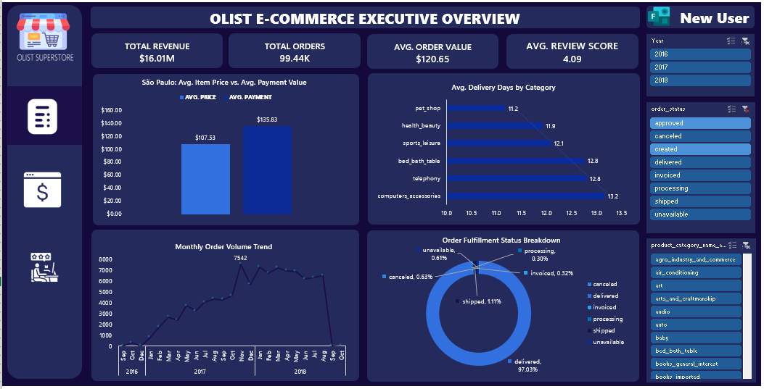
Excel Dashboard-1

Slide 11
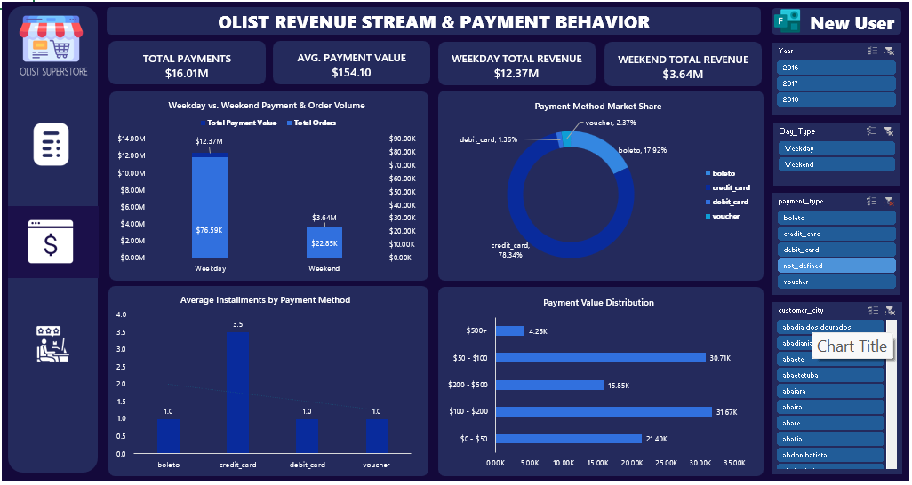
Excel Dashboard-2

Slide 12
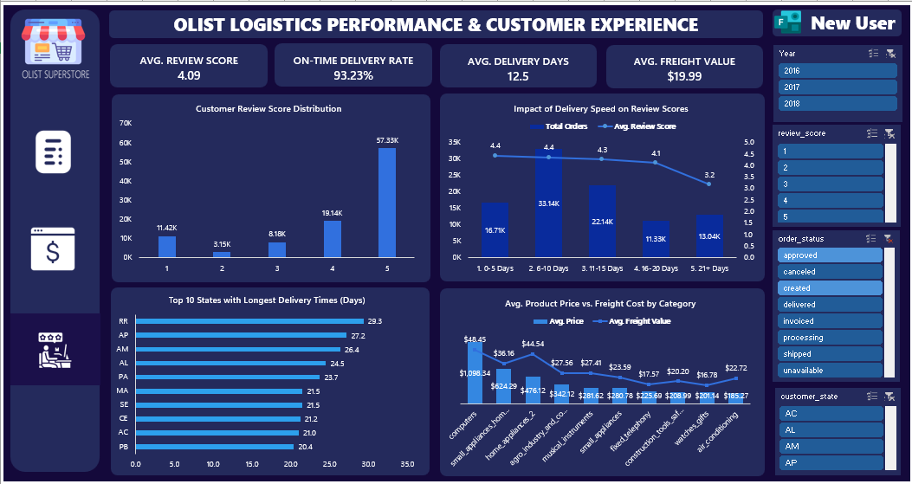
Excel Dashboard-3

Slide 13
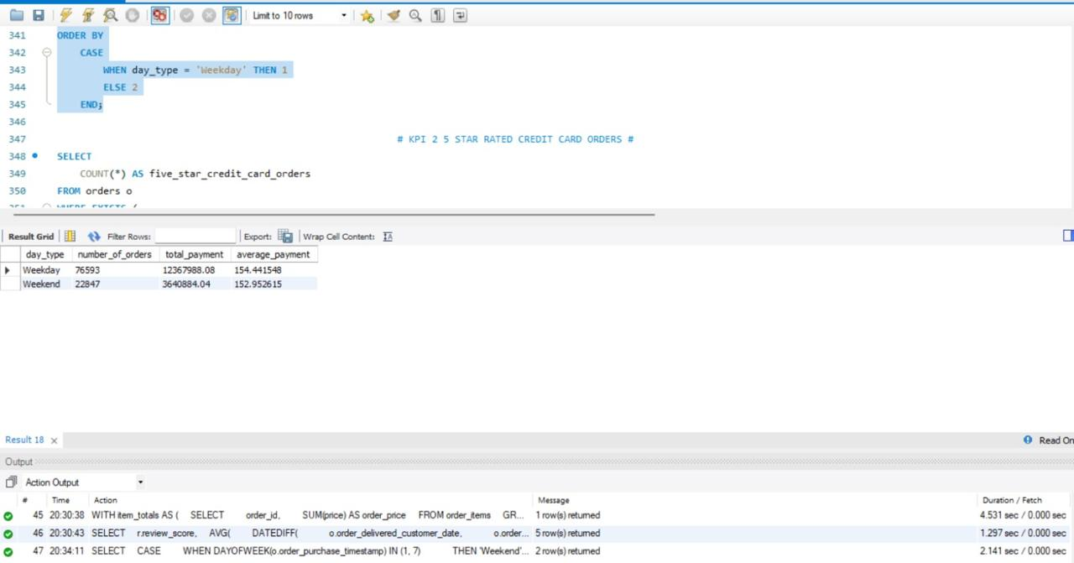
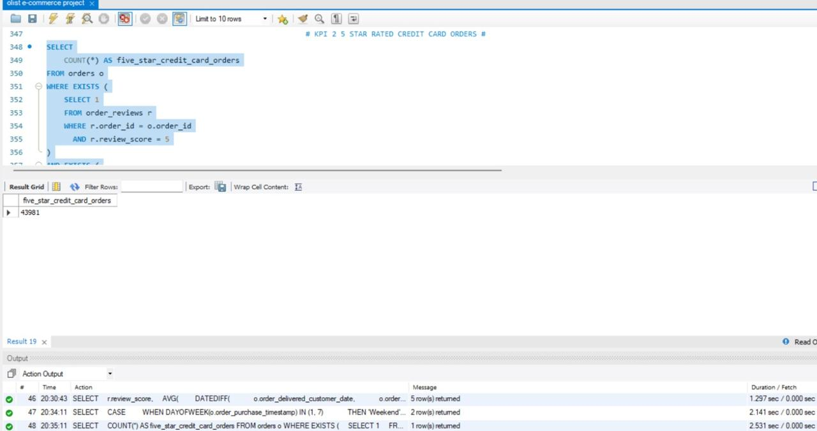
SQL KPI 1&2

Slide 14
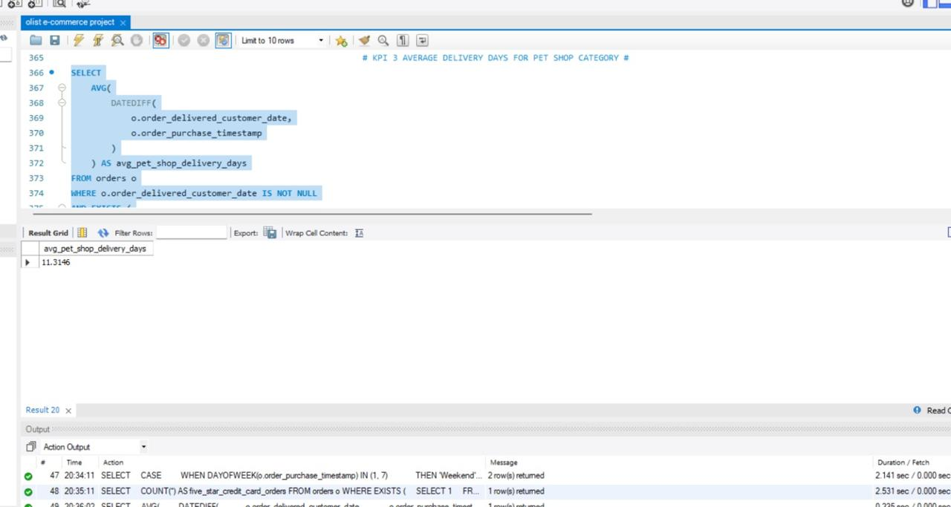
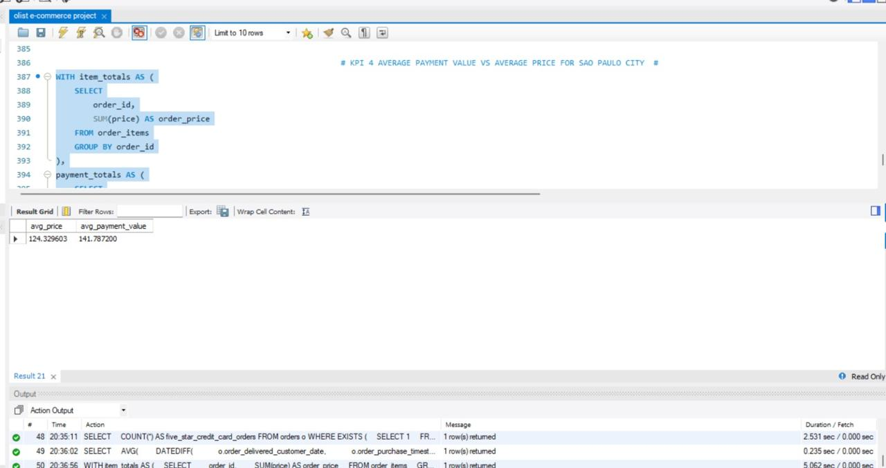
SQL KPI 3 & 4

Slide 15
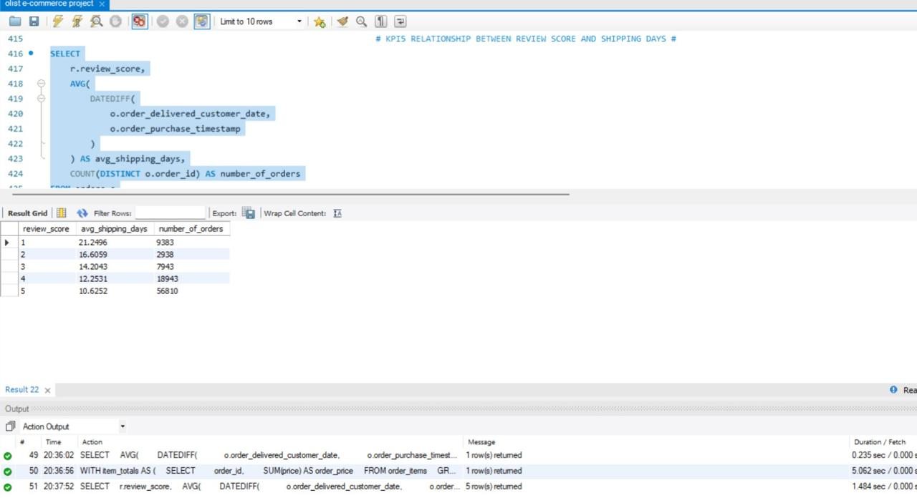
SQL KPI 5

Slide 16
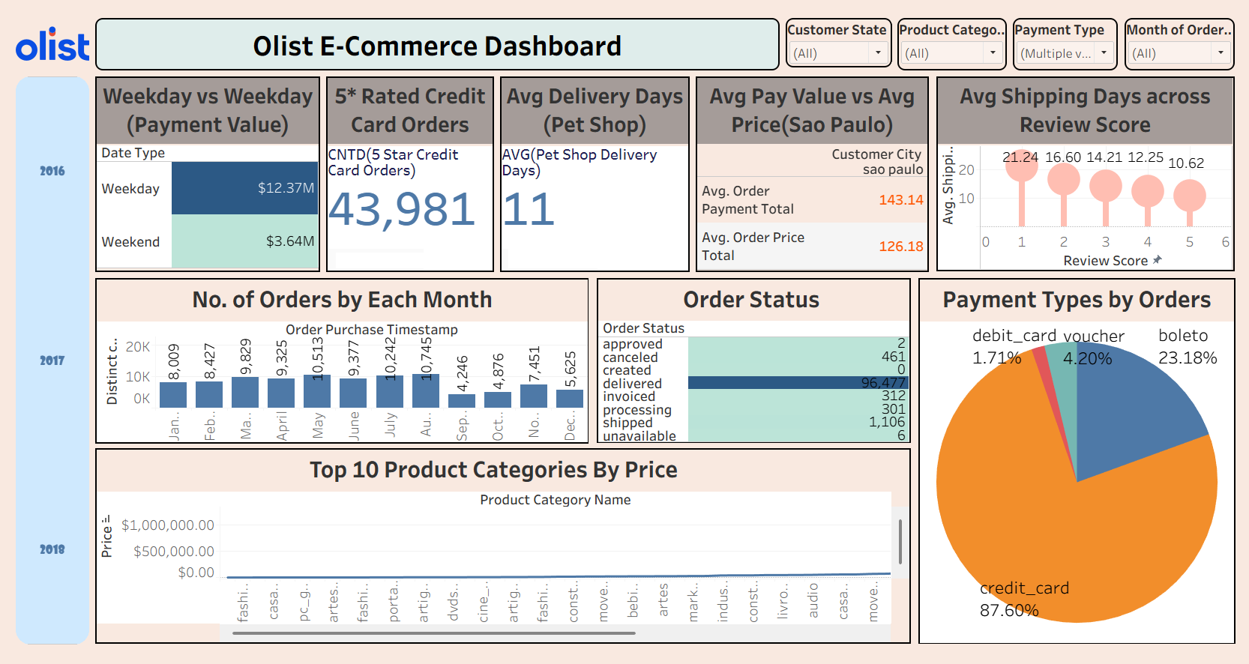
Tableau Dashboard

Slide 17
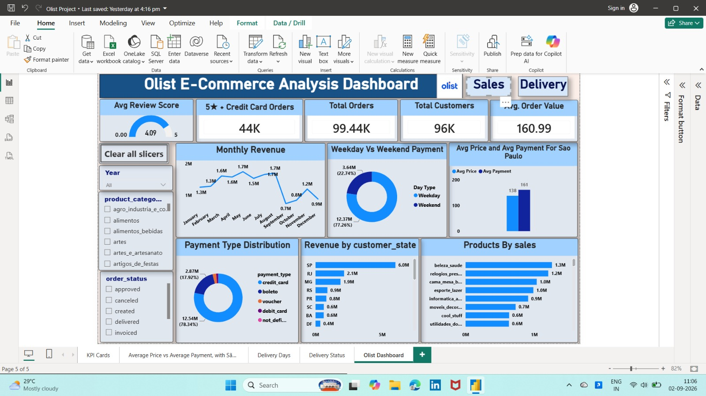
Power BI Dashboard-1

Slide 18
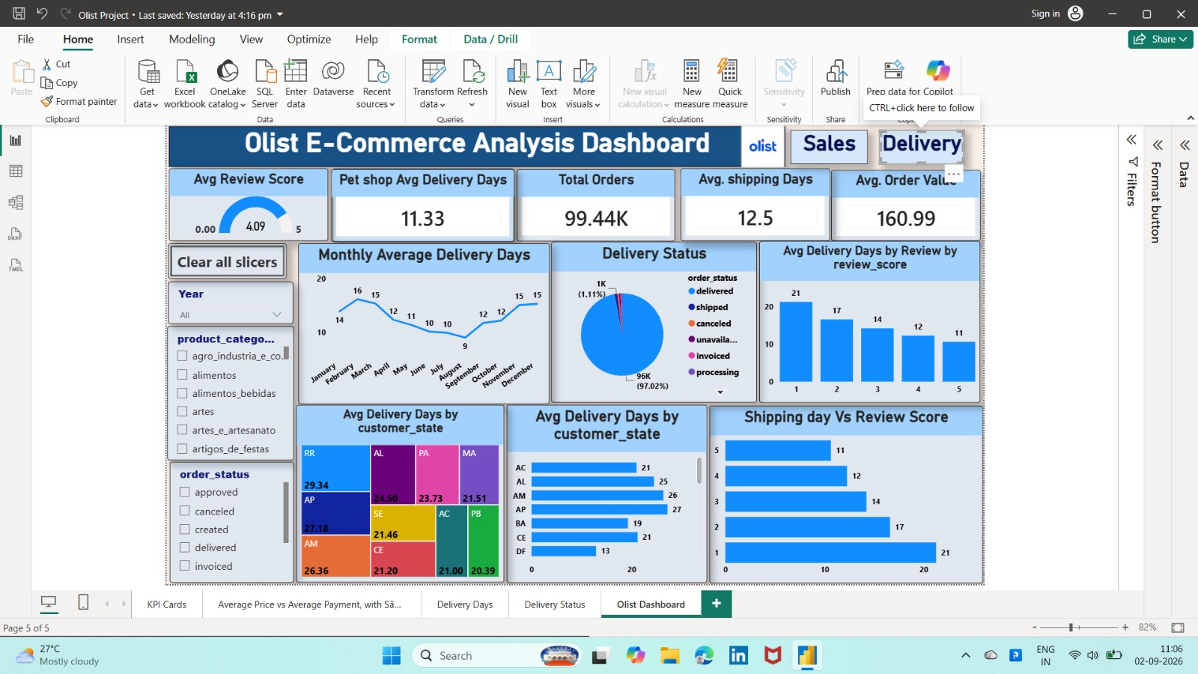
Power Bi Dashboard-2

Slide 19
INSIGHTS
Strong Sales & Customer Performance
The platform generated R$16.01M from 99,441 orders, with credit cards (78.34%) and weekday purchases (77.26%) dominating transactions. São Paulo and Beauty & Health are major contributors to overall revenue.
Delivery Directly Impacts Customer Satisfaction
Although 97.02% of orders were delivered and the average review score was 4.09/5, slower deliveries receive poorer ratings. 1-star orders take ~21 days vs ~11 days for 5-star orders, highlighting delivery optimization as a key improvement area.

Slide 20

RECOMMENDATIONS
Reduce delivery delays in slower regions through better logistics and route optimization.Faster deliveries can improve customer satisfaction and increase positive reviews.
Invest in popular categories such as Beauty & Health to drive further sales growth.Use targeted promotions and inventory planning based on product demand.
Maintain a smooth and secure experience for the widely used credit-card payments.Provide reliable digital payment options to improve customer convenience.
Analyze low-rated orders to identify delivery and service-related problems.Address these issues to improve reviews, loyalty, and customer retention.

Slide 21
CONCLUSION
The project successfully transformed raw e-commerce data into meaningful business insights using Power BI.
The analysis highlighted key patterns in sales, customers, payments, products, and delivery performance.
The results show strong overall business performance, with 99K+ orders and R$16M+ payment value.
Delivery time was identified as an important factor influencing customer satisfaction and review scores.
Overall, the dashboard supports data-driven decision-making and helps businesses identify opportunities for growth and operational improvement.

Slide 22

THANK YOU
Team Members:
Riya Jitendra vishwakarma
Nikhil Rohidas Naik
Siddesh satish kadam
Medabala Sujith Kamal Kumar
Akshata P sutar
Harshada Arvind chavan
Tammisetty Joji

